Slide 1
SecureNet
A CYBERSECURITY
PORTAL

Slide 2
01
Overview

Slide 3
In today's digital age, protecting our online communities from cyberbullying has become a paramount concern. SecureNet, a cutting-edge cybersecurity platform, is revolutionizing the way we combat this issue. By leveraging advanced analytics and machine learning algorithms, SecureNet not only identifies instances of cyberbullying in real-time but also predicts potential suspects, enabling swift action to protect those at risk. With SecureNet, we can enhance cybersecurity and ensure a safer online environment for all.

Slide 4
Abstract

Slide 5
AI integration in cybersecurity tackles modern cyber threats, employing ML and NLP for improved detection and response. Real-time threat intelligence, predictive analytics, and automated incident response herald a new era in defense strategies. The abstract explores ethical concerns, algorithm biases, and transparency, offering valuable insights to cybersecurity professionals and policymakers. It underscores ongoing research and collaboration as crucial for building a resilient digital future.

Slide 6
As the frequency and sophistication of cyber threats continue to rise, traditional cybersecurity measures are struggling to keep pace with evolving attack vectors. Current strategies often rely on static rule-based systems, which fall short in effectively detecting and mitigating dynamic and complex threats. This poses a significant challenge to maintaining the integrity of digital ecosystems. Addressing this gap is crucial for ensuring the security of sensitive information and critical infrastructures. This research aims to investigate the integration of artificial intelligence (AI) into cybersecurity practices, seeking to enhance threat detection, response, and prevention capabilities, and mitigate the challenges posed by the rapidly evolving cyber threat landscape.
Problem Statement

Slide 7
Drawbacks of the existing system
Traditional cybersecurity systems often rely on static rule-based approaches, making them less adaptable to rapidly evolving and sophisticated cyber threats. As a result, these systems struggle to keep up with the dynamic nature of modern attacks. It may lack advanced user and entity behavior analytics capabilities, making it challenging to detect anomalies in user behavior that could signal insider threats or compromised accounts.

Slide 8
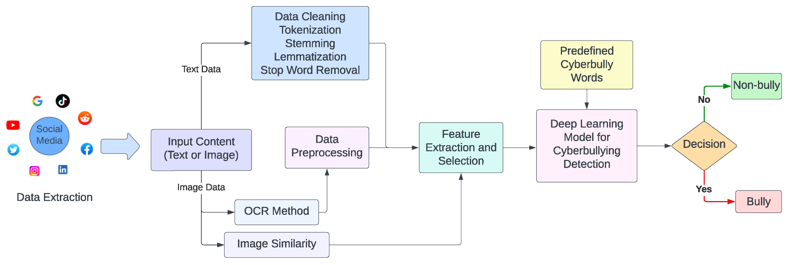
Flowchart

Slide 9
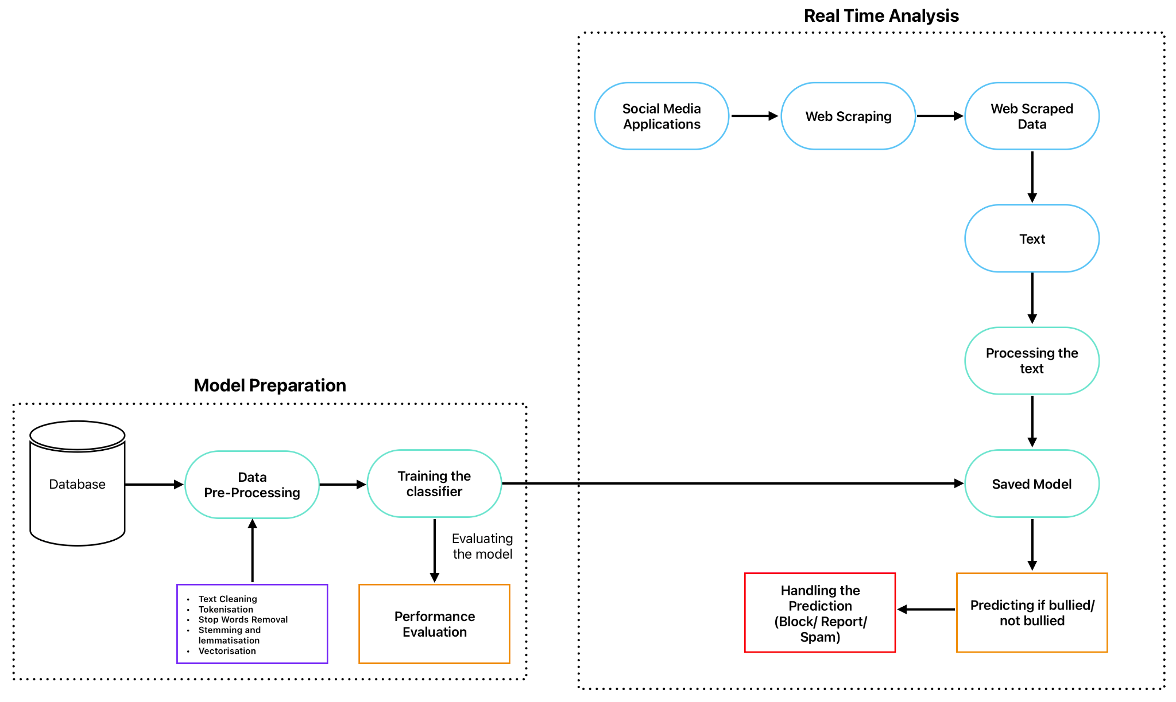
System Architecture

Slide 10
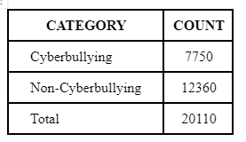
METHODOLOGY
A. Data Collection

Slide 11
B. Data Preprocessing
Text cleaning
Stopword removal
Vectorization
1
3
5
2
4
Stemming and lemmatization
Tokenization

Slide 12


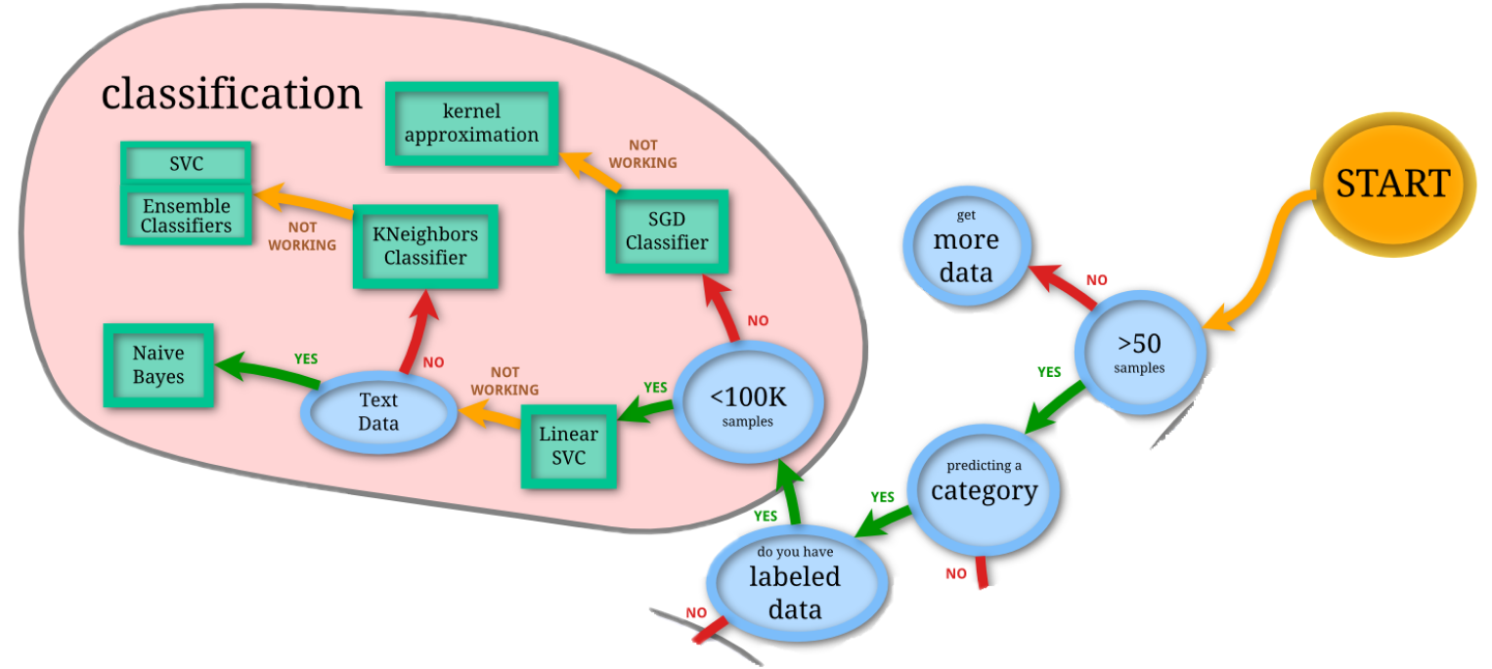
C. Model Selection

Slide 13
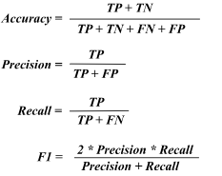
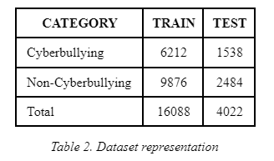
D. Model Training

Slide 14
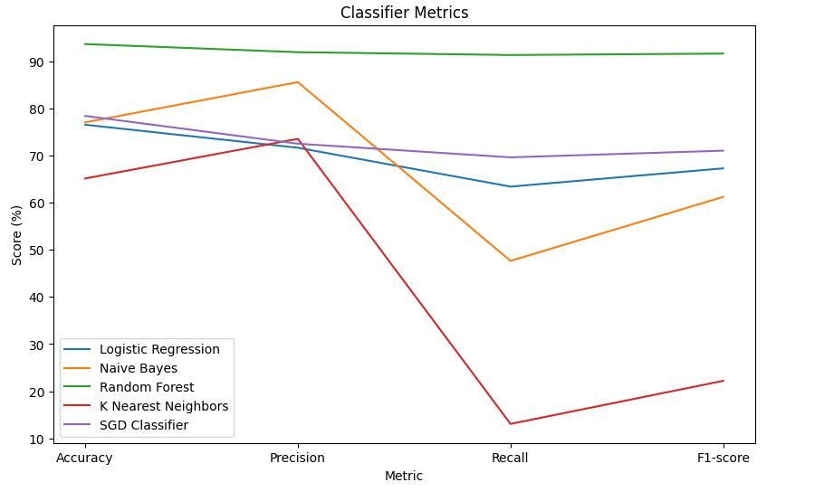
E. Model Evaluation

Slide 15
FUTURE SCOPE
Future endeavors could amplify the application's prowess by embracing cutting-edge natural language processing methods and live tracking. Safeguarding user well-being and adhering to ethical standards are paramount in crafting cyberbullying detection utilities. Infusing sentiment analysis and contextual comprehension into detection mechanisms might elevate their precision. Joining forces among researchers, social media platforms, and policymakers remains pivotal in refining potent tactics and instruments to thwart cyberbullying, fostering a secure digital realm for everyone.

Slide 16
Conclusion
In conclusion, implementing SecureNet is crucial for enhancing cybersecurity and creating a safer online environment. By addressing the challenges and following best practices, such as proper training, collaboration, and regular updates, we can accurately identify cyberbullying and predict suspects.

Slide 17

References
[1] Abdulkadir Bilen and Özer Ahmet, "Cyber-attack method and perpetrator
prediction using machine learning algorithms", PeerJ Computer Science, vol.7,
pp. e475, 2021.
[2] Rasha Al-majed, Amer Ibrahim, Abedallah Abualkishik, Nahia Mourad and
Faris. Almansour, "Using machine learning algorithm for detection of
cyber-attacks in cyber physical systems", Periodicals of Engineering and
Natural Sciences (PEN), vol. 10, pp. 261, 2022.
[3] Shyam Varan Nath, "Crime pattern detection using data mining", 2006
IEEE/WIC/ACM International Conference on Web Intelligence and
Intelligent Agent Technology Workshops, 2006.

Slide 18
Thank
You
Hemaya Dhanasekar
Pranesh Somasundar

